Slide 1
Policies
Briana Wham and Ana Enriquez

Slide 2

Open Research Data
New requirements from funders and publishers
Data Management Plans
Data Availability Statements
“F.A.I.R.” Data Repositories
Reproducibility

Slide 3
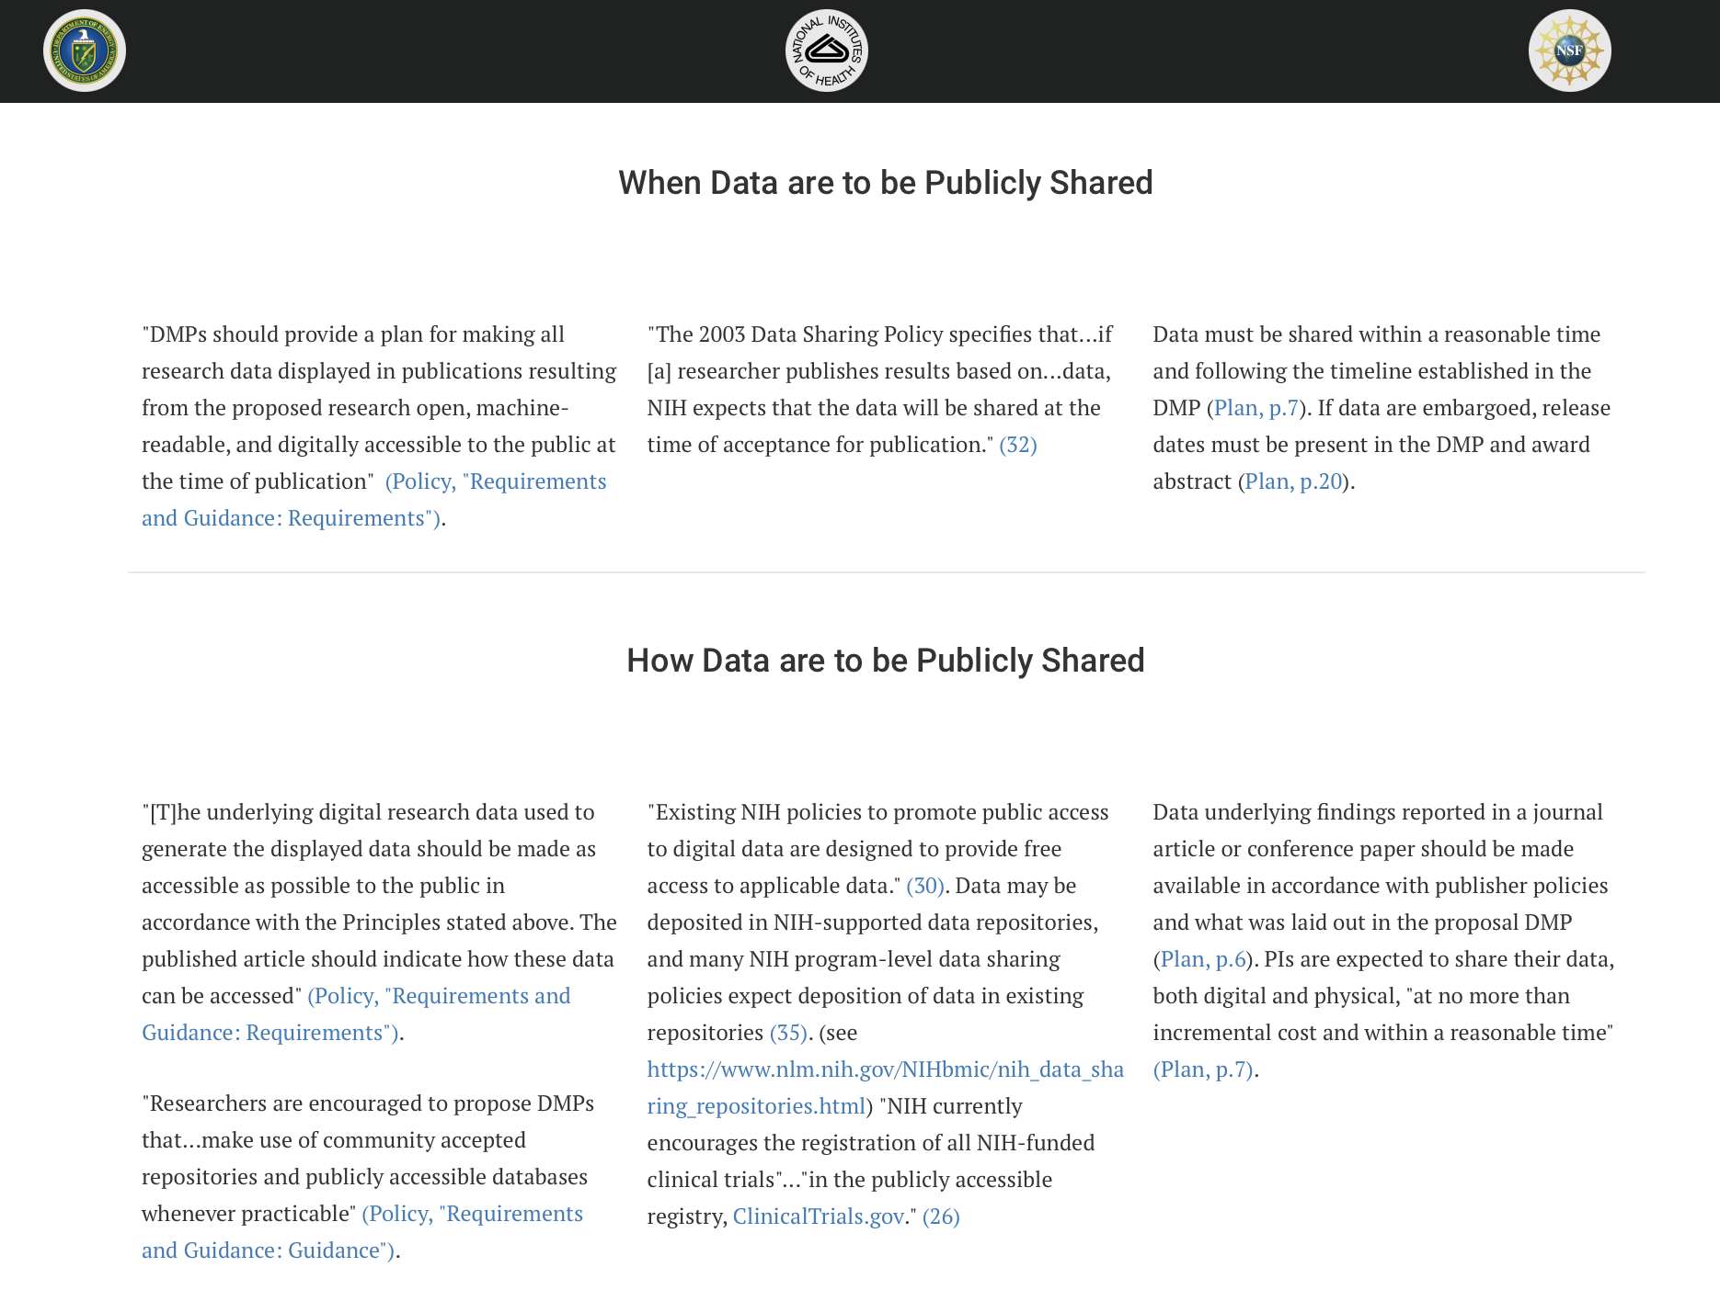
Data Management & Sharing Policies from Federal Funders
Policies differ slightly but generally require grantees to include a data management plan (DMP) and share final research data in a timely manner according to DMP.
Browse Data Sharing Requirements by Federal Agency: http://datasharing.sparcopen.org/data

Slide 4
Highlights of 2022 Nelson Memo
Aug. 2022
OSTP Nelson Memo Released
Feb. 2023
Publication & Data Plans due for agencies with more than $100M in R&D
Aug. 2023
Publication & Data Plans due to agencies with $100 M or less in R&D
Dec. 2024
Publication & Data Agency Policies Published
Research & Scientific Integrity Plans Due
Dec. 2025
Publication & Data Policy effective date
Dec. 2026
Research & Scientific Integrity Policy updates published
Dec. 2027
Research & Scientific Integrity Policy effective date
Applies to all federal agencies with research and development expenditures
Directs agencies to make taxpayer-funded research publications available immediately, at no cost to the public, thus eliminating 12-month embargo
Directs agencies to make the underlying data for that research available at no cost to the public at the time of publication
Directs agencies to reduce inequities in publication of and access to federally-funded publications and data
Directs agencies to improve scientific research integrity, including by using DOIs and releasing metadata
Notes:
This memo addresses and applies to all federal agencies with research and development expenditures directing them to make taxpayer-funded research publications available immediately, at no cost to the public, thus eliminating the 12 month embargo that is currently in place under the Holdren memo, to make the underlying data for that research available at no cost to the public at the time of publication, to reduce inequities in publication of and access to federally-funded publications and data, and to improve scientific research integrity by using DOIs and releasing metadata.

Slide 5
NIH Data Management & Sharing Policy
Effective January 25, 2023
Requires the submission of a Data Management and Sharing Plan (DMSP) for all NIH-funded research which generates scientific data
The approved DMSP becomes a term and condition of award and non-compliance could impact award terms and conditions as well as future funding decisions
Expects researchers to maximize appropriate data sharing in established data repositories
Sharing should occur no later than publication or end of award
Plans may justify exceptions (i.e., ethical, legal, privacy, technical factors)
Allows researchers to request funding for personnel costs or other fees related to data management and sharing activities, but the money must be spent during the grant’s award period
Notes:
Though this policy was announced and implemented prior to the Nelson Memo provides a good example of how the Nelson memo expectations for data management and sharing may be implemented at other agencies. This policy requires that a data management and sharing plan outlining how data acquired, generated, or collected will be managed, stored, shared, archived, and preserved is submitted alongside all proposals which generate scientific data. The approved data management and sharing plan becomes a term and condition of award and non-compliance could impact award terms and conditions as well as future funding decisions. Additionally, this policy sets the expectation that researchers maximize appropriate data sharing in established repositories. This means that while there is a requirement for managing data, sharing data is not required but researchers need to provide justification when data cannot be shared. Further, this policy allows researchers to request funding for personnel costs or other fees related to data management and sharing activities, but the money must be spent during the grant’s award period.

Slide 6
What is a Data Management & Sharing Plan?
A 2 page document describing:
How the scientific data that is generated or acquired as part of the research project and accompanying metadata will be organized, stored, documented, shared, preserved, and archived.
Identifies any potential restrictions or limitations to sharing.

Slide 7
Data Types
Related Tools, Software, and/or Code
Standards for data/metadata
Data Preservation, Access, and Associated Timelines
Access, Distribution, or Reuse Considerations
Oversight of Data Management and Sharing
Elements & Format of a DMSP
Plans should be 2 pages max and submitted as a PDF in the “Other Plan(s)” field of the PHs 398 form.
https://grants.nih.gov/grants/guide/notice-files/NOT-OD-21-014.html
Notes:
Data Type: Identifying data to be preserved and shared
Related tools, software, code: Tools and software need to access and manipulate data
Standards: Standards too be applied to scientific data and metadata
Data preservation, access, timelines: Repository to be used, persistent unique identifier, and when/how long data will be available
Access, distribution, reuse considerations: Description of factors for data access, distribution, or reuse
Oversight of data management: Plan compliance will be monitored/managed and by whom

Slide 8
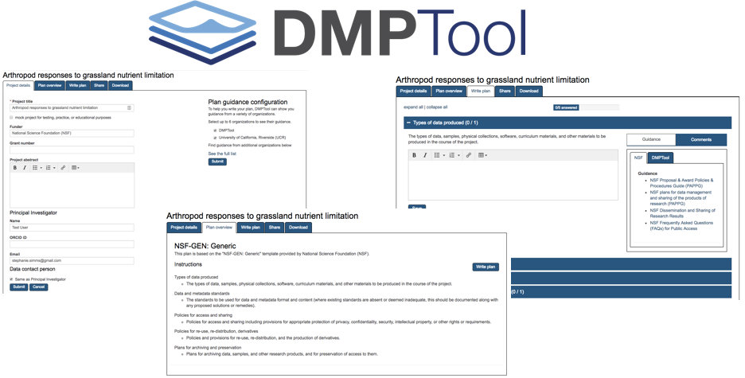
dmptool.org
Notes:
In particular, we facilitate use of the DMPTool, a free, open source, online application that helps researchers create data management plans.

Slide 9
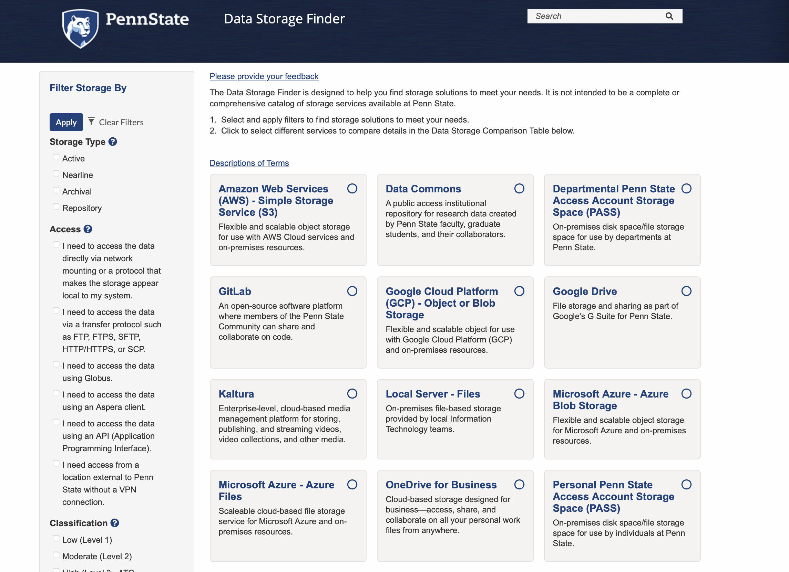
PSU Data Storage Finder
datastoragefinder.psu.edu

Slide 10
Penn State Research Data Management Policy Purpose
The intent of this policy is to clarify ownership of and responsibility for Research Data collected during the course of University Research, to define and encourage active data management practices, including Research Data storage and retention, and provide expectations for handling Research Data should a researcher leave the University.
Notes:
Courtney
The purpose of this policy came about based on identified needs from various areas. As Briana previously discussed, many of our peer institutions have drafted such policies in order to promote good data stewardship and scientific practices, but also to clarify ownership, responsibility and expectations regarding data management.

Slide 11
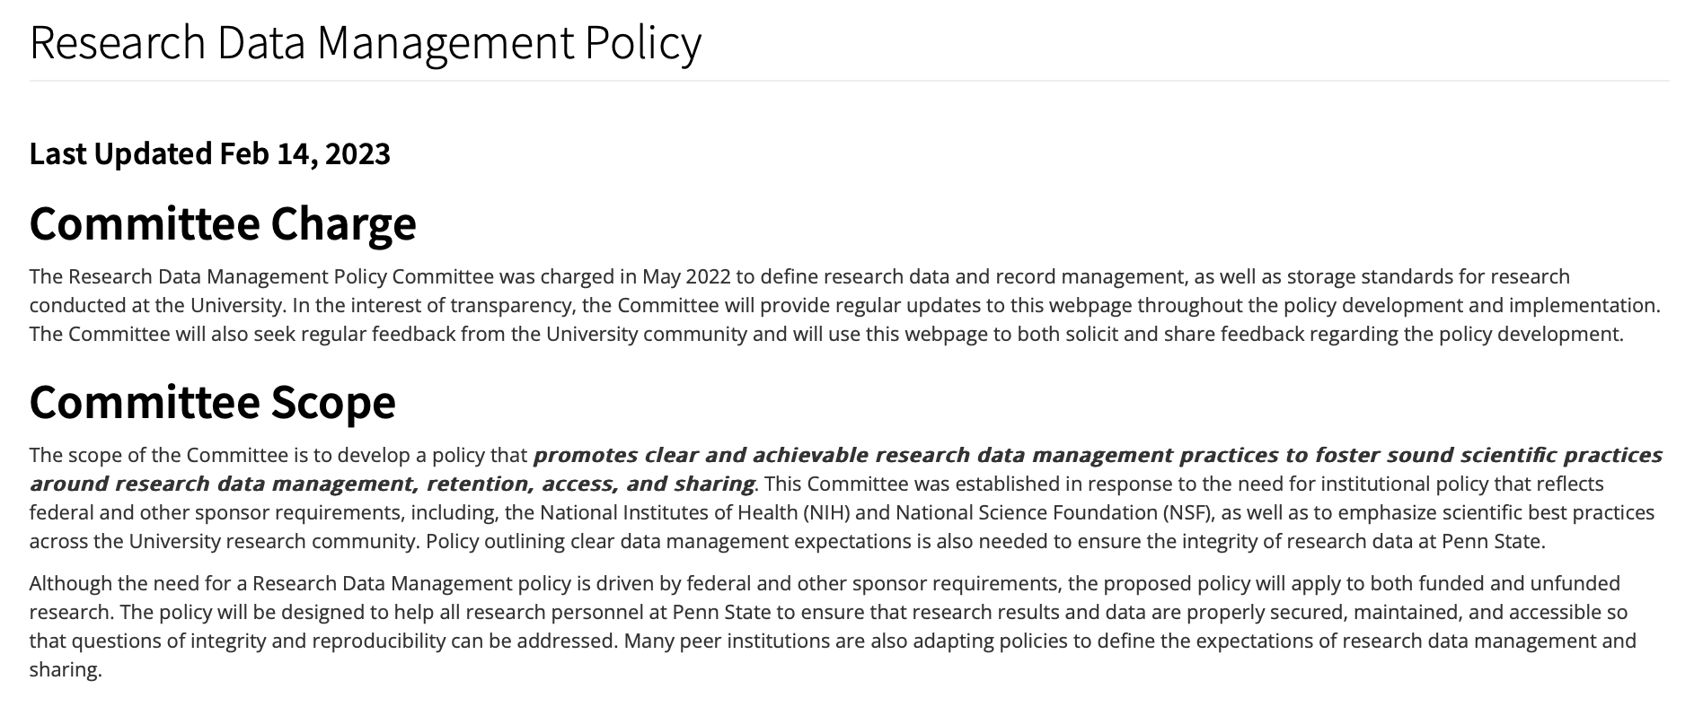
Penn State Research Data Management Policy Initiative Website
https://www.research.psu.edu/research-data-management-policy ​
Notes:
Briana
Additionally, this committee set a goal to offer transparency throughout the policy development process and to that aim, developed a webpage to share updates and document progress to date. You can access this webpage at research.psu.edu/research-data-management-policy

Slide 12
Copyright and Licensing

Slide 13
Is research data copyrightable? It depends...
Copyright does not cover:
"any idea, procedure, process, system, method of operation, concept, principle, or discovery"
Works of the U.S. federal government
Materials with expired copyrights (anything published before 1929, some things published 1929-1989)
Copyright can cover:
Creative expressions of facts
Creative selections or arrangements of uncopyrightable elements
Photographs, video, transcripts, interviews, software/code
And more...

Slide 14
If there's a copyright, who owns it?
Creator holds copyright unless the work was created within the scope of employment.
Copyright holder controls licensing decisions.

Slide 15
Penn State Policy IP01
Research IP
"discoveries, inventions and creations with potential commercial value that result from research activities"
Must be disclosed to Office of Technology Management. University holds rights. Open licensing is possible, but you must work with OTM.
Scholarly IP
"materials resulting from scholarly, literary, and artistic work such as journal papers, books, ... including (but not restricted to) print materials, video recordings, audio recordings, and digital materials"
"Copyright ownership of such works generally rests with the creator(s) unless their creation is directed by the University, or is subject to a sponsor's agreement that provides for a different ownership."

Slide 16
Fair use
Fair use allows use of copyrighted material without permission from the copyright holder.
Scholarship and research uses are especially likely to be fair use.
E.g., text and data mining research
Caveats
Contracts/terms of use can override your fair use rights.
Fair use may not cover sharing the material/data publicly, even if it covers your research project.

Slide 17
Licenses to know
Creative Commons Licenses
Suite of licenses with remixable elements: Attribution (BY), NonCommercial (NC), ShareAlike (SA), NoDerivatives (ND)
Designed for any type of copyrightable work other than software.
Creative Commons Public Domain Dedication (CC0)
(technically not a license)
Open Source Software Licenses
Copyleft licenses include “share alike” restrictions: GPL, etc.
Permissive licenses place few restrictions on use: BSD, MIT, etc.

Slide 18
Contact Info
Research Informatics and Publishing Department
Email: repub@psu.edu
https://outlook.office365.com/owa/calendar/PSURepubServices@PennStateOffice365.onmicrosoft.com/bookings/ (book consultations here)
Office of Scholarly Communications and Copyright
Email: copyright@psu.edu
Web: copyright.psu.edu (book appointments here)

